Slide 1
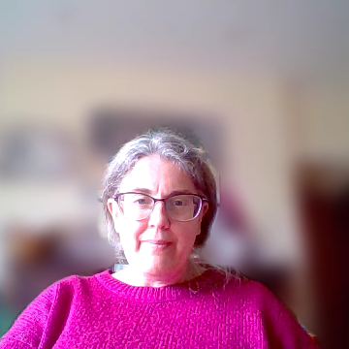
Impacts
Psychological – low self esteem, 5xs as likely to have clinical depression, low confidence, low self worth, eating disorders/body image issues
Freedom of movement and participation – lack of safety to move about the world, take up space in public/online/home life
Violence and harassment – and access to justice – a “daily grind of harassment”
Notes:
No one way to be impacted – many women might recognise all of these, some might not recognise any – different women experience misogyny in different ways depending on how close they are to the relatively mainstream sense of “normal” as we’ve discussed.

Slide 2

Impact in workplaces
Gendered pay gap – shutting women off from top roles, or holding them only in roles which require caring/soft skills and less physical labour
Lower job satisfaction for women/lack of sense of belonging
TUC Research:
One in two women have experienced some form of sexual harassment in the workplace.
Four out of five do not report to their employer, often because of the well-founded fear of reprisal and further victimisation.
“In my personal experience, I have struggled with both stress and anxiety in part as a result of the sexism I experienced within the workplace. I dreaded going to work every morning, and it took its toll on both my mental and physical health, and I became a shell of the person I once was”. Young woman in YWT Research
Notes:
TUC Research from 2016 and intersectionality important here:
BME women face double discrimination through racism and sexism.
37 per cent of BME women state race and gender as the reason for experiencing verbal abuse.
Seven in ten LGBT+ workers and disabled women workers have experienced at least one form of sexual harassment at work.
Nearly a third of young workers have experienced sexual harassment, often from third parties.

